Slide 1
Pod Config

Slide 2
Kubernetes objects can be created in two formats.
Json
Yaml
Yaml is easy to use and easy to understand language. This is the most commonly used.

Slide 3
Config structure
There are four basic and mandatory fields when we create config file/manifest file for any object.
apiVersion – It explains the apiVersion where an object was released
kind - The kind of object going to be created (pod, deployment etc)
metadata - It provide information about the configuration
spec - This describe what actually you want Kubernetes to build.

Slide 4
List of apiVersion of various kind
Kind | apiVersion
ConfigMap | v1
DaemonSet | apps/v1
Deployment | apps/v1
Job | batch/v1
PersistentVolumeClaim | v1
PersistentVolume | v1
Pod | v1
ReplicaSet | apps/v1
ReplicationController | v1
Secret | v1
Service | v1

Slide 5
What does each apiVersion mean?
alpha
API versions with ‘alpha’ in their name are early candidates for new functionality coming into Kubernetes. These may contain bugs and are not guaranteed to work in the future.
beta
‘beta’ in the API version name means that testing has progressed past alpha level, and that the feature will eventually be included in Kubernetes. Although the way it works might change, and the way objects are defined may change completely, the feature itself is highly likely to make it into Kubernetes in some form.
stable
These do not contain ‘alpha’ or ‘beta’ in their name. They are safe to use.

Slide 6
Pod config
apiVersion: v1
kind: Pod
metadata:
name: my_first_pod
labels:
app: prod
tier: front-end
spec:
containers:
- name: <container_name>
image: nginx

Slide 7
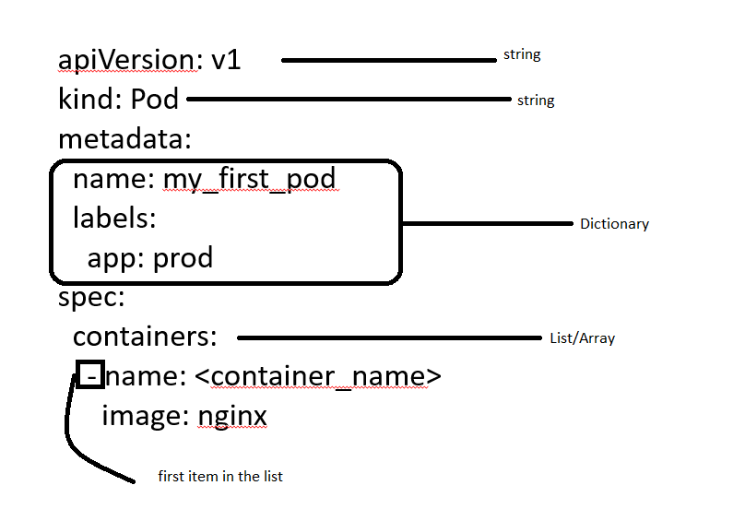

Slide 8
How to deploy the pod manifest file
To deploy the pod in Kubernetes, we can use the “kubectl create” command as depicted below.
Syntax:
kubectl create -f <pod_manifest_file>.yml
e.g. kubectl create -f testpod.yml
F flag used for file.
We can also use kubectl apply command to create a pod.
kubectl apply -f <pod_manifest_file>.yml

